Slide 1
ITSM – Session 5
Dr. Phalachandra HL
Acknowledgements:
Significant portions of the information in the slide sets presented through the course in the class are extracted from IT Systems Management -Rich Schiesser and other books/Internet. Since these were intended for presentation in the class room for teaching, instructor resources has been requested from the publisher, but not received yet. I would like to sincerely thank, acknowledge and reiterate that the credit/rights remain with the original authors/publishers only

Slide 2
Lecture 5
Performance & Tuning

Slide 3
IT Systems Management
Recap - 1
IT Infrastructure Systems Management involves managing the IT Services running on the IT infrastructure environment components like the Servers, Disk Storage, DBs, Networks and Desktop environments, and providing a stable and responsive IT environment, which supports or furthers the Business of the organization, while being Available, Responsive, Cost efficient, Secure, Scalable,…
We discussed on the support needed from executives, organization structure and positioning of the groups which provide these management services, given that one of the KSF are people, we discussed on approaches for staffing and retaining people with required skills and skill levels, the personal and business ethics or lack of it and it’s impact in-terms of legislation and what that drives into organizations
We discussed on how the ITSM best practices are shared through de-facto standards like ITIL. We discussed the evolution of ITIL to the current ITIL 4 and the IT Service Life cycle of Service Strategy, Service Design, Service transition and Service operation and Continuous Improvements.

Slide 4
IT Systems Management
Recap - 2
Evolution of the IT Systems management as customer services and an approach of how to get to good service IT in an organization by identifying the key customers of IT, the key services used by these customers, the processes which support these Key services and the inputs to these processes.
Then as part of the 12 Key processes which would discuss as part of the course, we discussed on the Availability management and the goal of managing customer expectation of the expected/agreed/guaranteed levels of functioning of the Services and Systems in a cost-effective, consistent and timely manner. We discussed on the definitions of the terminologies for consistent interpretation, contrasted with High Availability, looked at how do we measure availability, pro-activeness in Availability and the 7 Rs or approaches towards achieving High Availability and techniques that have being used to understand the reason for the disruption of availability and how to streamline them
We also looked at approach towards assessing an Infrastructure’s ITSM processes and specifically the Availability Process using worksheets in terms of quality efficiency and effectiveness using around 10 attributes.

Slide 5
Performance acceptance
Performance acceptance means deployment

Slide 6
Performance & Tuning
Definition & Generic Characteristics of Performance-Tuning
Performance & Tuning are two related activities which are normally combined into a process. Hardware and Software Infrastructures and their relationships are continually tuned to meet up with/Optimize for the performance goals established or simply to improve the performance.
Defn: Performance and tuning is a methodology to Maximize throughput and Minimize response times on all platforms for all forms of workloads like batch jobs, online transactions, and Internet activities in a cost effective fashion
General observations
Addition of new hardware is seldom the best approach of solving a performance problem. The performance gain in most situations are temporary and sub-optimal. Its most likely the bottleneck will be relocated to another place
Since workloads keep changing, Performance and tuning are ongoing, highly iterative processes and for consistent acceptable good performance, this has to be treated and dealt in that (ongoing and iterative) manner.
Overall planning of the type and volume of current and future workloads (capacity planning) is essential to a robust process for performance and tuning.
Notes:
Incident, Availability, Capacity and Service Level Management in ITIL together support Performance Management

Slide 7
Can performance bottlenecks be solved for ever by tuning? or would you just move the performance bottleneck to a place where there is minimal possibility of hitting it.
Is there an example which you can share on how a performance bottle neck was addressed by your IT organization

Slide 8
Performance & Tuning
Difference between Performance-Tuning and Other Processes
Performance-Tuning | Other Processes
Consists primarily of two major activities | Primarily consists of one major activity
Will Include - Reporting of - Real-time performance monitoring - periodic management trend reports (daily, weekly, or less-frequent basis.) - Conducting of variety of analyses, adjustments, and changes to a whole host of parameters | Will have one focus area
Normally has multiple subprocess owners | Normally has one overall process owner
Shares ownership across multiple departments | Typically Centralized ownership in one department
Nature of the tasks is continuous and ongoing. Performance monitoring happens all of the time. | Tasks have definitive start and end dates. E.g. Changes are implemented, problems are resolved, and new applications become deployed
Tuning a portion of the infrastructure environment to correct a performance problem can be a highly iterative | Seldom iterative because most of the tasks associated with them are of a one-time nature
Process tools vary widely among the resource environment and number of tools are used | Process tools are usually shared across departments e.g. Problem management system
Utilizes a large number of diversified metrics which depends on the kind of environment | Processes utilize a small number of similar metrics

Slide 9
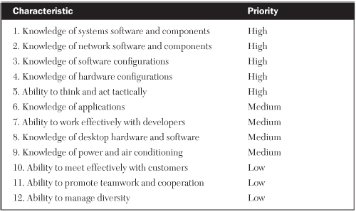
Performance & Tuning
Preferred Characteristics for a Performance-Tuning Process Owner
Since this could involve addressing multiple resource areas, the process owner(s) will need to have great depth of an area and good understanding of the other areas
Notes:
Process Owners and Sub-process Owners

Slide 10
Performance & Tuning of Infrastructure Areas
Performance and Tuning of Infrastructure can be looked at from the perspectives of a Server Environment, Disk Storage Environment, Network Environment, Desk top compute environment and Databases as the discrete components of typical IT Infrastructure.
In case of cloud Infrastructure, this could also be looked at from the perspective of managing Virtualized physical components and managing these abstracted virtual components for performance.
This could be in terms of
Selection of the VMs or Containers based on the workload characteristics
Allocation policies for VM
Redefining Network and Firewall Usages
Implementing autoscaling of services
Implementing some of the caching services
Adopting architectures like micro services architecture, event driven architectures
Cont.

Slide 11
Performance & Tuning of Infrastructure Areas
1. Server Environment
This refers to looking at performance tuning across all compute platforms from mainframe computers, midrange computers, workstations to servers.
Major places in a server environment where performance bottlenecks can be seen & addressed are
Processors
The number and power of processors influence the rate of work accomplished for processor-oriented transactions.
The extent of utilization of the processor also has a bearing on the performance. Keeping the processor utilization (as a tunable lever) to be ~70% can lead to more optimal performance
Main memory and size of swap space
Size of the main memory, and configuration of the main memory for swap space (part of main memory to hold frequently used portions of programs to reduce time-consuming I/O operations) are potential bottlenecks and levers for tuning for performance
Number and size of Buffers
The number and size of Buffers (which are high-speed registers of main memory that store data being staged for input or output operations) can trade off the amount of memory available for process-oriented transactions
Cont.

Slide 12
Performance & Tuning of Infrastructure Areas
1. Server Environment (Contd.)
Major places in a server environment ..(Cont.)
Cache
Size and availability of the Cache (lower performance than main memory and used for storing programs and data which are likely to be used immediately), in the server environment is an additional lever for tuning for performance
Number and type of channels
Number, type and capacity of the IO channels or the IO buses (could be FC, SCSI, SATA ..) can effect performance and are other levers to tweak for performance of the Server environment
Metrics commonly collected in a server environment for optimizing performance include:
Processor utilization percentages
The frequency of swapping in and out of main memory
Percentage of hits and misses to the main memory cache
The length and duration of processing queues
The percentage of utilization of channels
The amount of processor overhead used to measure performance
Notes:
Trade-offs …

Slide 13
Performance & Tuning of Infrastructure Areas
2. Disk Storage Environment
Disk storage equipment is the next resource which can have a bearing on performance-tuning.
Disk storage environment performance can be impacted by the following
Cache Memory in a Disk Subsystem
Significant number of disk subsystems have Cache built into them. The size of the cache, the algorithms which are used for prefetching & flushing can have a significant impact on the performance (Discuss in the session)
Volume groups
Volume groups are a logical grouping of physical disk drives. The intent is to improve performance with reduced seek-and-search times by combining frequently used groups of physical volumes into one logical group. Data could be distributed across different physical disks which would mean more physical paths and have them to be logically grouped for providing performance.
Striping
Striping is a performance improvement techniques in which blocks of data that are to be read or written sequentially are stored across multiple disks (usually across the same logical volume) to increase the number of data paths to overcome the difference of disk write speed and data transfer rates.

Slide 14
Performance & Tuning of Infrastructure Areas
2. Disk Storage Environment (Contd.)
Disk storage environment performance can be impacted by the following (Contd.)
Storage area networks
Configuring and using the storage disk equipment into a SAN can enhance the performance. This coupled with addition of say FC switches will enable multiple paths for the data to be transmitted/received and hence enhancement of performance. This could increase the fan-in. This is offset by the cost which needs to be balanced.
Network‐attached storage
Configuring the network as a NAS could reasonably increase the performance as the disk is directly connected to the network, but is limited by the network bandwidth
Extents
Extents are contiguous areas of storage reserved for a file or an object in a file system, represented as a range of block numbers. In case of amount of data needing to be written exceeds the amount of original contiguous disk space allocated, another extent is added to it. So instead of abnormally terminating the request, the operating system looks for additional available space on the disk volume and extends the original contiguous space. The negative perspective would be .. Larger the number of extents, longer the response times.

Slide 15
Performance & Tuning of Infrastructure Areas
2. Disk Storage Environment (Contd.)
Disk storage environment performance can be impacted by the following (Contd.)
Fragmentation
Extents are needed due to fragmentation of disks. Higher the fragmentation, larger the number of extents and the other way too. Reallocating for files reducing the extents, defragmentation are good tuning methods to improve fragmentation

Slide 16
Performance & Tuning of Infrastructure Areas
3. Database Environment
The physical layout of a database can greatly influence the eventual response times of inquiries or updates.
Databases in large companies can grow to hundreds of columns and millions of rows.
The placement of critical files such as system, data, log, index, and rollback files within the database can spell the difference between acceptable responses and outright lockups.
Common performance issues associated with a database environment is as below
Placement of table files
A table file, which describes the various tables that reside within the database, is a critical navigational map of a database that serves as its data dictionary.
Since most DB requests are channeled through the table file, the placement of this file is extremely important to delivering acceptable online performance.
The optimal location for this file is in the main memory of the server where fetch times are the quickest. However, the size of this file often prevents its being located there. In that case, as much of it as possible should be loaded into the cache memory of the disk array when space is available.
Initialization parameters
There can be dozens of parameters from which to select and specify initial values. Some of the more common of these are database block size, the shared pool size for locating the data dictionary in memory, the system global area (SGA) for selected shared table files, log buffers, and the database block buffers for data files.

Slide 17
Performance & Tuning of Infrastructure Areas
3. Database Environment (Contd.)
Common performance issues associated with a database environment (Contd.)
Placement of data files
When accessing data on disk drives, proper placement on the volume—as well as the volume’s placement within a volume group—influences the amount of time it takes to complete database-access requests
Indexes and keys
Judicious use of indexes and keys is another performance and tuning aid that can drastically reduce table lookup times.
Keys are used to identify records uniquely in a table. The indexes are lists that hold the keys (lists of keys) along with a pointer to the remainder of the data. Searching for a particular record is typically much quicker using an index, key, and pointer scheme because it eliminates the need to search the entire database.
Indexes also allow for multiple sorting of records within groups of tables or keys. Complex queries with multiple constraints will be faster with this.
The use of indexes and keys must be balanced with the expense of additional storage, the overhead of processing and maintaining the indexes, and the updating and merging of keys.
Notes:
*

Slide 18
Performance & Tuning of Infrastructure Areas
3. Database Environment (Contd.)
Common performance issues associated with a database environment (Cont.)
Locks
Locks protect the integrity of a record of data by making it inaccessible to unauthorized users. Locks often are used with multi-user files and databases to ensure multiple updates are not made simultaneously.
Locks implementation needs to be carefully planned since the overuse of locks can extend both disk space and access times
Balance of system resources
Balancing system resources of processors memory, channel, and disk is necessary to ensure no single resource becomes saturated or grossly under-utilized in the quest for good performance.
Monitoring the usage and proactively ensuring the balance among the devices is the way for ensuring performance

Slide 19
Performance & Tuning of Infrastructure Areas
3. Database Environment (Contd.)
Common performance issues associated with a database environment (Cont.)
Access patterns
Understanding the access patterns into a database is one of the best ways to optimize an application’s performance.
Anticipating what the read and write sequences are likely to be, and to which parts of the database they will likely occur, allows database administrators to map out the physical database in an optimal configuration.
At the same time, performance specialists can configure disk-volume groups to align as closely as possible to the expected disk-access patterns.
Measuring end-to-end response times would be relevant to verify the validity of these adjustments.
Database fragmentation
Database records are rewritten in locations that are different from their optimal starting points. This causes data to be not optimally placed for its anticipated access pattern and the fragmentation of the data records causing less than efficient use of the disk space.
Periodic defragmentation based on the reports and statistics can help in addressing the above

Slide 20
Performance & Tuning of Infrastructure Areas
4. Network Environment
Variety of factors influence the performance of a network, beginning with its overall design and topology..
Common Network issues which can influence Performance and Tuning are
Bandwidth
Capacity planning when not based on number of concurrent users, peak traffic workloads and an estimation of transaction arrival pattern and types can cause bottlenecks on the quantum of data planned for.
Robust capacity plan based on network load simulation using varying workloads should address this
Line speed
Speed of the link or line is another parameter which can affect the network performance. There will need to be a balancing of the speed-bandwidth to the total cost of operation and planning/Tuning for the same which can address it.
Protocols
This is dictated by business, programming, and application requirements. In instances where alternatives are possible, giving consideration to potential performance impacts, especially when running diagnostic programs such as traces and sniffers can be approaches to address the same

Slide 21
Performance & Tuning of Infrastructure Areas
4. Network Environment (Contd.)
Common Network issues which can influence Performance and Tuning (Cont.)
Single Sign-On
There is a trade-off between performance and security. The convenience and performance savings of logging on only once instead of multiple times for access to the network, operating system, database management system, and a particular application must be weighed against the potential security exposures of bypassing normal password checks.
Most applications have robust security features designed into them to mitigate this risk
Number of Retries
Transmission errors and particularly transient ones occur periodically in a network. Network Protocols have this factored in and retry for a period of time or number of retries before its flagged as an error. This value if very large or too small can impact the performance of the network and needs to adjusted
Non-Standard Interfaces and Broadcast Storms
Suppliers can sometimes offer interfaces to increase the compatibility of these devices with a network. These when working fine, can support the business need at acceptable productivity/performance levels.
They can also cause major performance problems such as locking up lines, introducing interference, or, in extreme cases, flooding the network with nonstop transmissions called broadcast storms when not compatible.
Caution needs to be exercised with heightened awareness of network performance in these scenarios

Slide 22
Performance & Tuning of Infrastructure Areas
5. Desktop Compute Environment
Common Desktop Environment issues which can influence Performance and Tuning are
Processors and Memory
The type and power of the processor is influenced by the applications which will be running on the desktop environment
This is also dependent on the type and how many of them (no of windows and the applications therein) you are running concurrently.
Number of applications starting and running in the background like the Updaters for OS/Apps, Anti Virus S/W, Parental protection software, Anti-spam, Firewalls and Anti spyware can impact the performance
Disk storage space
Having applications locally on the disk, disks with current technologies like SSD, availability of disk space for swap etc. can have a bearing on these environments
Network connections
The speed of the network ports, the bandwidth/speed coming in from the access points, number of users on the switch/hub can impact the performance.
Diagnostic and Administrative tools
Diagnostic tools if running and not initialized properly can impact performance. Similarly tools like the inventory management, asset management etc. send/receive large amount of information and can have a bearing on the performance of the Desktop computer environment

Slide 23
Assessing Performance and Tuning
Continuing with the Worksheet for assessing the overall quality, efficiency, and effectiveness of the performance & tuning process. (without weighing factor)
Quality
Executive support
Process owner
Process documentation
Efficiency
Supplier involvement
Process metrics
Process integration
Streamlining/automation
Effectiveness
Customer involvement
Service metrics
The training of staff
Characteristics within each category is rated on a scale of 1 to 4 . 1 - 4 indicating no presence to a large presence of the characteristic.
Notes:
*

Slide 24
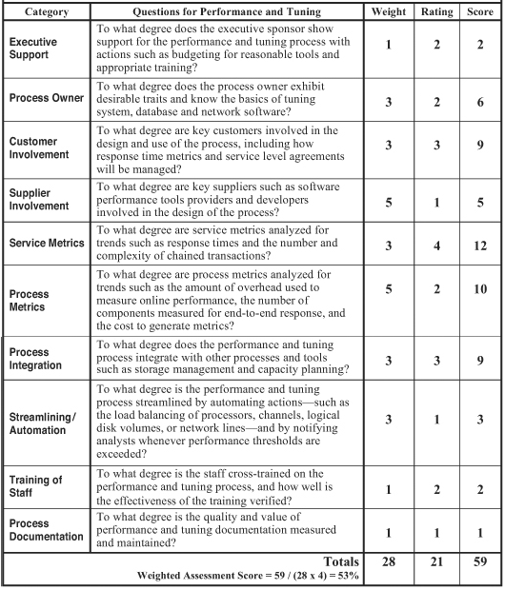
Assessing Performance & Tuning
Work sheet with weighing factor
Maximum Weight – 28
Maximum Rating Value - 4
Maximum Weighted Score
= Max Weight * Max Rating Value Max Weighted Score = 28 * 4
= 112
Weighted Assessment Score
= Total Score/Max Weighted Score
= 59/112 = 0.52678 = ~0.53
= 53%

Slide 25
Measuring and Streamlining the Performance and Tuning Process
We can measure and streamline the performance and tuning process with the help of the assessment worksheet
We can also measure the effectiveness of a performance and tuning process with
Service metrics such as response times and the number and complexity of chained transactions.
Process metrics such as the amount of overhead used to measure online performance, the number of components measured for end-to-end response, and the cost to generate metrics
These can help us gauge the efficiency of this process.
We can streamline the performance and tuning process by automating certain actions like
Load-balancing of processors, channels, logical disk volumes, or network lines
Notifying analysts when performance thresholds are exceeded.
Notes:
.

Slide 26
Production Acceptance Process

Slide 27
Production Acceptance Process
Definition and Terminologies
Defn: Production acceptance is the process which supports consistent and successful deployment of application systems into a production environment, regardless of the platform
Few key terminologies from the above definition
Consistent :
Consistent does not necessarily mean identical across platforms
There are essential steps of the process which needs to be done for every production deployment and there are other steps that can be added, omitted or modified depending on the type of platform selected for production use
Deploying into a production environment
Process of deployment is complete only when all planned users are running on the new system
This could take several months for installations with large number of users
Application System
Any group of software programs necessary for conducting company’s business
The end-users of these applications are primarily (but not necessarily) departments outside of IT
This excludes software under development & software used as tools for IT support

Slide 28
How does your organizations IT deploy applications? Is there a best practice which you can share with the rest of the class

Slide 29
Production Acceptance Process
Benefits of a Production Acceptance Process
An effective production deployment process offers several advantages for applications department, executive management, various groups within the IT infrastructure, customers, and suppliers
Beneficiary | Benefits
Applications | Adequate network & system capacity are planned and available for the Application
 | If application needs additional resources/budget/time, this can be planned upfront
 | Support groups could be trained in advance
Executive Management | Increases the probability of successful deployment with minimum surprises and disruption
 | Supports effective planning and opportunities for cost reduction
Infrastructure | Provides an early view of requirements facilitating better capacity planning
Customers | Early involvement, Conducive schedules, better experience as well planned and tested
Suppliers | Involves suppliers, supports communication and co-ordination, leverage experiences
PTO

Slide 30
Production Acceptance Process
Implementation Steps for an effective production Acceptance Process - 1
The following 14 steps are necessary for implementing an effective production acceptance process
Identification of an executive Sponsor:
An executive sponsor is necessary to ensure ongoing support and cooperation between the Infrastructure group and the Applications development group.
This could be the CIO, Infrastructure group head or other executive from the Infrastructure group
Executive sponsor being the champion of the process
Should be as high as possible in the Organization
Should be capable of persuading other executives both inside and outside of IT to follow the lead.
Responsible for executive leadership, direction, and support for the process.
The executive sponsor is also responsible for selecting the process owner and addressing conflicts that the process owner cannot resolve
Providing marketing assistance.

Slide 31
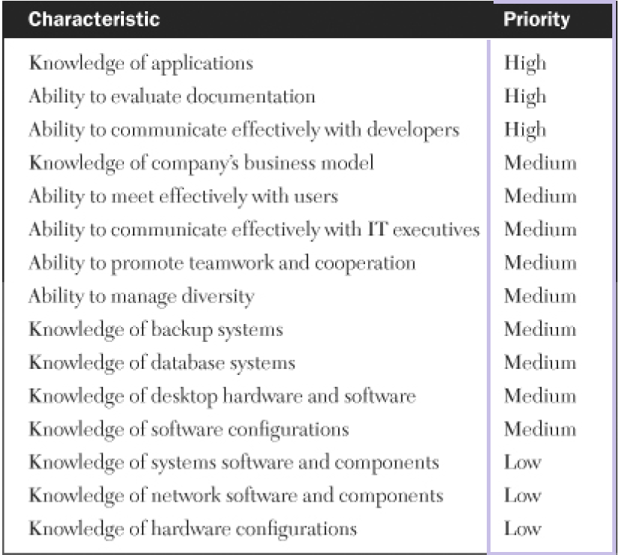
Production Acceptance Process
Implementation Steps for an effective production Acceptance Process - 2
Selecting the process owner:
Executive sponsor will select the production acceptance process owner from the infrastructure organization
Typically some one from the IT infrastructure team or with knowledge of Infrastructure, as most of the activities will fall within the IT Infrastructure group
Effective communication skills as they will interact with users at one end & IT executives at the other.

Slide 32
Production Acceptance Process
Implementation Steps for an effective production Acceptance Process - 3
Soliciting Executive Support
Production acceptance requires policies and decisions about the design of the process to be backed up by the sponsor, and pushed down to both the applications development and infrastructure departments.
Executive support from both of these departments should be solicited for ensuring this support
Assemble a Production Acceptance Team:
A cross functional team will need to be assembled by the process owner for designing and implementing the production acceptance process
This team should consist of representatives of development organization, operations, technical support, capacity planning, help desk, and database administration.
Having adequate and proper representation (multiple based on size) from all key groups will ensure proper implementation and buy-in/support for the process.

Slide 33
Production Acceptance Process
Implementation Steps for an effective production Acceptance Process - 4
Identify and Prioritize Requirements:
These requirements are a set of activities/actions which are needed for an effective design of the Production acceptance process
These Requirements will need to be agreed-upon and prioritized to ensure successful implementations of Production Acceptance Process.
Some of the common high priority requirements could be like
Ensuring early involvement of the operations, technical support, helpdesk, network services and database administration roles when implementing a new application
Ensuring that the process of gathering capacity requirements for the process is compatible with the gathered capacity requirements
Application documentation shared with operations before the production turnover
Developing and enforcing of management policy statements
Developing an uninstall or rollback mechanism

Slide 34
Production Acceptance Process
Implementation Steps for an effective production Acceptance Process - 5
Develop Policy Statements:
Policy statements will define acceptable methods and behaviors with-in the team or simply ways things are done, which will help setting a consistent expectations on compliance, enforcement, and accountability, when communicated to all levels
The cross-functional team should develop policy statements for a production acceptance process which should be then approved by the executive sponsor
E.g. All major new versions of existing production applications are to go through the formal production acceptance process prior to deployment into production
All new mainframe or server‐based applications are to go through the formal production acceptance process prior to deployment into production
Nominate a Pilot System:
A pilot system is a small-scale preliminary study conducted of a small/minimal impact application, using the new deployment process and ironing out of issues before the formal process can be institutionalized.
In environments where production acceptance process is new and significantly different from the way applications are deployed, its effective to introduce the process through a pilot.

Slide 35
ITSM : Production Acceptance Process
Implementation Steps for an effective production Acceptance Process - 6
Design Appropriate Forms:
Forms are used to solicit the requirements for an application including the activities/actions needed to be performed in the environment before this application can be deployed using the production acceptance process being designed
The cross-functional team in the requirements step would have envisaged on the requirements, their priority and evolved on the different types, and characteristics of formal forms to be used with a production acceptance process, which are very specific to the organization.
In this phase the forms are designed to make them unambiguous, based on the right roles, timing etc. Some of the forms would be filled up in the beginning at the time of project approval for building of the production acceptance process, some a couple of months before the process is rolled out into production, and some immediately before the process is executed and some just after the deployment is completed. E.g.
Production acceptance request form contributed by PM, Network Ops manager, System Administration (at the time of project approval). This can contain
High level summary of the project including the description
High level schedule
Risks and categorization
Service Level information in terms of who is spending how much time
Minimum system requirements
Notes:
Eg. Skill Set : one enterprise may use primarily IBM mainframes with IBM’s information management system (IMS) databases while another may use mostly Sun Solaris platforms with Oracle databases.

Slide 36
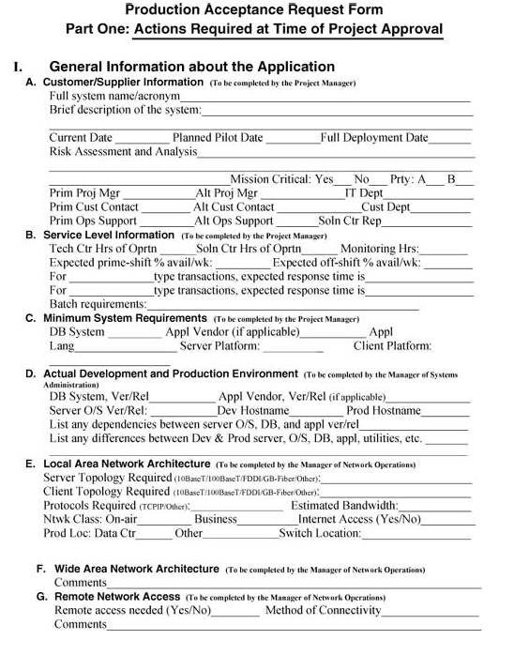
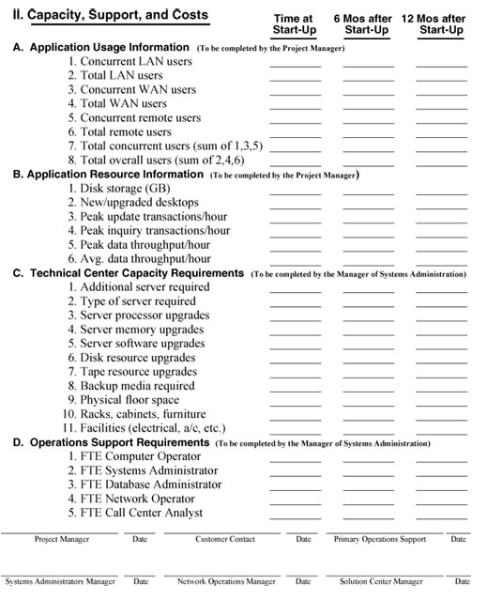
ITSM : Production Acceptance Process
Implementation Steps for an effective production Acceptance Process - 7
Design Appropriate Forms (Contd.): Eg. Production acceptance request form (Contd.)
Notes:
Eg. Skill Set : one enterprise may use primarily IBM mainframes with IBM’s information management system (IMS) databases while another may use mostly Sun Solaris platforms with Oracle databases.

Slide 37
ITSM : Production Acceptance Process
Implementation Steps for an effective production Acceptance Process - 8
Design Appropriate Forms (Contd.):
Capacity planning form on (at the time of project approval)
Physical infrastructure
Application usage information
Application resource information
Technical center capacity requirements
Operations support requirements like FTE for different roles
Documentation from the Applications (few weeks before the start-up)
Architecture, System flow diagram, Backup requirements, Disaster recovery requirements, User acceptance test plans, User guides, List of all infrastructure tasks
Test plans and Training plans (few weeks before the start-up)
Documentation updates, and Closing on Service level agreements etc. (During/just after deployment)
Document the Procedures:
The procedures involved for this process has to be effectively documented and must be accessible.
Notes:
Eg. Skill Set : one enterprise may use primarily IBM mainframes with IBM’s information management system (IMS) databases while another may use mostly Sun Solaris platforms with Oracle databases.

Slide 38
ITSM : Production Acceptance Process
Implementation Steps for an effective production Acceptance Process - 6
Execute the Pilot System:
Since the pilot system is identified, forms signed and procedures are in place, the pilot system is executed.
This involves User testing and acceptance, along with the involvement of support groups such as technical support, systems administration, and help desk
Conduct a Lessons-Learned Session:
This is the pilot run retrospective session, with all the key participants including representatives from the user community, development area, support staff, and help desk involved with the pilot execution.
Revise Policies, Procedures and Forms:
The recommendations from the retrospective sessions may involve changes to policies, procedures, forms, test plans, training techniques etc. and may need to be revised once agreed by the cross functional team
Notes:
Eg. Skill Set : one enterprise may use primarily IBM mainframes with IBM’s information management system (IMS) databases while another may use mostly Sun Solaris platforms with Oracle databases.

Slide 39
ITSM : Production Acceptance Process
Implementation Steps for an effective production Acceptance Process - 7
Formulate Marketing Strategy
Once the final policies, procedures and forms are in place, the process owner and design team should formulate and implement a marketing strategy to ensure widespread acceptance of the process.
The marketing plan should include the benefits of using the process with the active support of the executive sponsor and his peers, with the cross functional team being the evangelists within their organizations.
Examples of any quick wins as evidenced by the pilot system; testimonials from users, service desk personnel & support staff will help support the message
Follow-up for Ongoing Enforcement and Improvements
Due to various factors like the Changing priorities, conflicting schedules, budget constraints, turnover of staff or management, lack of adequate resources there can be a de-emphasis on the novel process.
Follow up with reviews, postmortems, and lessons learned to constantly improve the overall quality, enforcement of following of the process, and continuous improvement of effectiveness of the process will help in ensuring ongoing support and consistent use
Notes:
Eg. Skill Set : one enterprise may use primarily IBM mainframes with IBM’s information management system (IMS) databases while another may use mostly Sun Solaris platforms with Oracle databases.

Slide 40
ITSM : Production Acceptance Process
Deployment of the Production Acceptance process for deploying a New Application
We discussed on how the production acceptance process would be designed, approved, documented, tested, and implemented.
Execution of the installation is not part of the Production Acceptance process described above. Having said that an application, when the forms are filled up as specified, following the procedures of the production acceptance process discussed earlier, should ensured of a successful deployment.
Paraphrasing, Once an application is approved to be deployed in the IT infrastructure, the development manager Involves the Infrastructure group and submits the required forms. This will enable the Infrastructure personnel to plan, coordinate, and plan for & provision the required resources and train the personnel from the technical support, system administration and helpdesk prior on the application prior to the deployment.
Once the resources are provisioned, following the well documented procedure from the Production Acceptance process should ensure successful deployment of the application
Notes:
Succession planning for the key personnel involved in the process is equally important to ensure that the new process would continue to be effective in the long-haul, and make it resilient to changes of key personnel
Postmortem at the end of 2-3 weeks is also equally important to carry forward the learnings

Slide 41
ITSM : Production Acceptance Process
Full Deployment of New Infrastructure & then Application deployment
Once the forms are filled up if you were assembling the Infrastructure from scratch, then it would involve
Build up the physical datacenter room
Install redundant power cabling
Install racks
Test the facilities
Install the server, networking, and storage hardware
Allow for a burn-in period
Check the power and cooling usage
Configure the infrastructure components
Install systems management tools
Test systems management processes
Follow the deployment process
Scenarios for Go-Live: Big Bang Parallel changeover or Phased changeover

Slide 42
ITSM : Production Acceptance Process
Distinguishing New Applications from New Versions of Existing Applications
Using of the Production Acceptance process for new versions of existing applications depends on the amount of changes that the new version has that would impact customers and infrastructure groups
If the new version of the application has more than minimal impact on users, support staff, service desk personnel then the process followed should be like for deploying for a new application.
All of the steps like
The test plans to be developed
Customer acceptance pilots should be formulated
Capacity requirements should be identified well in advance
Support staff and service desk personnel to receive updated training
Customers should be communicated with the changes on what they are going to see
have to be done before the Application deployment using the production acceptance process.
Notes:
Eg. Skill Set : one enterprise may use primarily IBM mainframes with IBM’s information management system (IMS) databases while another may use mostly Sun Solaris platforms with Oracle databases.

Slide 43
ITSM : Production Acceptance Process
Distinguishing Production Acceptance from Change Management
Both production acceptance and change management handle software changes
Production acceptance is a special type of change that involves many more elements than the typical software modification like
Capacity forecasts
Resource requirements
Customer sign-off
Service desk training
Close initial monitoring by developers
Production acceptance is involved solely with deploying application software into production whereas change management covers a wide range of activities outside of production software, such as hardware, networks, desktops, and facilities
Notes:
Eg. Skill Set : one enterprise may use primarily IBM mainframes with IBM’s information management system (IMS) databases while another may use mostly Sun Solaris platforms with Oracle databases.

Slide 44
ITSM : Production Acceptance Process
Case Studies: Generic factors considered
Case studies of Production Acceptance processes as in real-life environments to relate into it
Contrasting different Case studies will need some common factors to be considered
Business-oriented attributes
Type of industry of the company (Manufacturing, High technology, Entertainment, Services)
Total number of its employees at the time of the study
Number of years it had been in business
IT Oriented attributes
Number of IT workers
Number of processors by platform
Number of desktops
Production Services oriented attributes
Total number of applications in production
Number of production applications deployed per month
Existence of a production services department
To which group the production services department reported

Slide 45
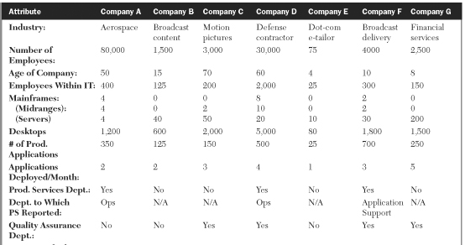
ITSM : Production Acceptance Process
Case Studies: Generic factors considered
Notes:
Eg. Skill Set : one enterprise may use primarily IBM mainframes with IBM’s information management system (IMS) databases while another may use mostly Sun Solaris platforms with Oracle databases.

Slide 46

ITSM : Production Acceptance Process
Case Studies: Generic factors considered
Notes:
Eg. Skill Set : one enterprise may use primarily IBM mainframes with IBM’s information management system (IMS) databases while another may use mostly Sun Solaris platforms with Oracle databases.

Slide 47
ITSM : Production Acceptance Process
Case Study A
Context: Aerospace firm, Research, Cutting-edge technology focused company. 80000 Employees, 400 IT with 4MF+4 Servers+1200 DTC datacenter equipment. Typically ran 350 applications daily, and 2 new applications a month.
No formal QA, bit of change management and production acceptance process but manual. People focused with 2 trained expert engineers handling it based on tacit knowledge. Minimum Documentation. Compartmentalized physically distributed organization. Metrics collected.
Positive Outlook: Willing to try out new things, wants to improve
Limitations: Non effective communications, minimal documentation, tacit training, no formal repeatable process for improvements.
Operations team-Initiated formal production acceptance process.
Learnings: Development and operations team need to work together. Infrastructure group to support the Production acceptance process.

Slide 48
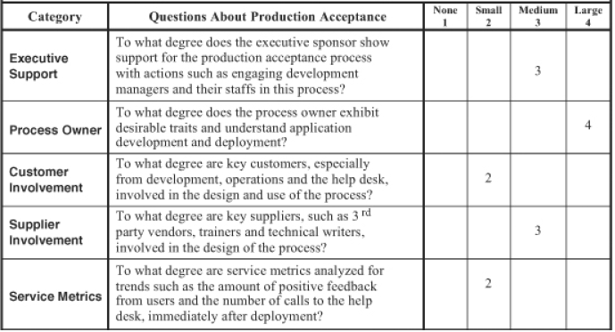
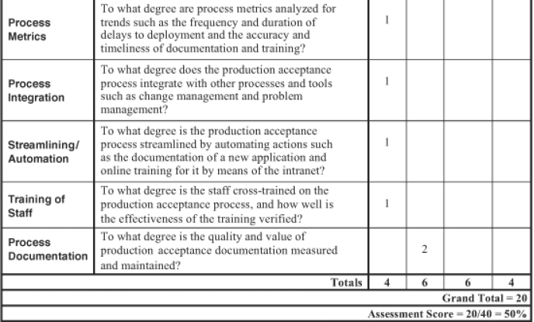
ITSM : Production Acceptance Process
Assessment Worksheet for Case Study A

Slide 49
ITSM : Production Acceptance Process
Case Studies : Lessons Learnt as per the book
Case Study A
Ensure the operations department is involved very early with a new application projects. This helps ensure that the appropriate operation’s group provides or receives the proper resources, capacity, documentation, and training required for a successful deployment.
Support from Infrastructure groups are essential
Case Study B
Plan for and ensure long range commitments of IT
Consider a change management process prior to a Production Acceptance process
Case Study C
Organization structure can help or reduce the effectiveness.
IT executives should ensure that operations control the PA process and that development is involved in the process design from the start
Case Study D
Commitment to follow the processes in spite of pressures
There are significant benefits in standardizing across divisions and sites. This can help in mergers integrations.
…
Notes:
Case study 2: Reshuffling of applications, Process run by consultants and was not well trained for future and documented.
Case study 3: PA process with application development and Infras were not trained nor support well
Case study 4: Cut backs did not allow processes focus, mergers led to turf wars, High priority projects bypassed the processes

Slide 50
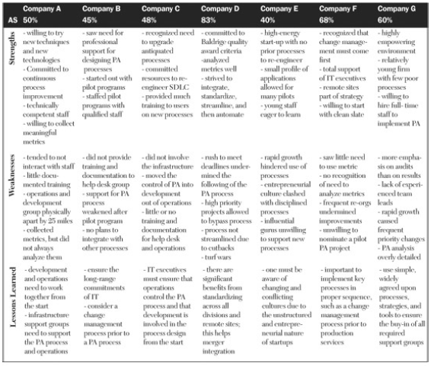
ITSM : Production Acceptance Process
Case Studies

